Slide 1
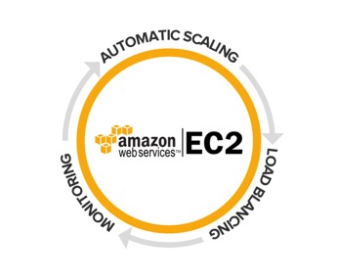
Amazon (AWS) EC2 (Elastic Cloud Compute)
Mahmut Bilgen

Slide 2
Scope
What is cloud computing?
What other cloud providers?
AWS : Core Services
Connection Tools (Putty, ssh terminal, pem, key files etc.)
Amazon EC2 Management Portal Details
DEMO – Creating EC-2 (Linux/windows)
Hands on Session

Slide 3
What is Cloud Computing?
Cloud computing is the
on-demand delivery of compute power,
database storage,
applications,
and other IT resources
through a cloud services platform via the internet
with pay-as-you-go pricing.

Slide 4
Advantages and Benefits of Cloud Computing
Trade capital expense for variable expense
Instead of having to invest heavily in data centers
only pay for how much you consume
Benefit from massive economies of scale
lower variable cost than you can get on your own.
AWS can achieve higher economies of scale which translates into lower pay as you go prices.
Stop guessing capacity
Eliminate guessing on your infrastructure capacity needs.
capacity decision
idle resources
or limited capacity.
scale up and down as required with only a few minutes notice.
Notes:
Trade capital expense for variable expense
Instead of having to invest heavily in data centers and servers before you know how you’re going to use them, you can only pay when you consume computing resources, and only pay for how much you consume.
Benefit from massive economies of scale
By using cloud computing, you can achieve a lower variable cost than you can get on your own. Because usage from hundreds of thousands of customers are aggregated in the cloud, providers such as Amazon Web Services can achieve higher economies of scale which translates into lower pay as you go prices.
Stop guessing capacity
Eliminate guessing on your infrastructure capacity needs. When you make a capacity decision prior to deploying an application, you often either end up sitting on expensive idle resources or dealing with limited capacity. With cloud computing, these problems go away. You can access as much or as little as you need, and scale up and down as required with only a few minutes notice.

Slide 5
Advantages and Benefits of Cloud Computing
Increase speed and agility
new IT resources are only ever a click away,
resources available to your developers
dramatic increase in agility for the organization
Stop spending money on running and maintaining data centers
Focus on your business, not the infrastructure. ,
own customers, rather than on the heavy lifting of racking, stacking and powering servers.
Go global in minutes
Easily deploy your application in multiple regions around the world with just a few clicks.
Notes:
Increase speed and agility
In a cloud computing environment, new IT resources are only ever a click away, which means you reduce the time it takes to make those resources available to your developers from weeks to just minutes. This results in a dramatic increase in agility for the organization, since the cost and time it takes to experiment and develop is significantly lower.
Stop spending money on running and maintaining data centers
Focus on projects that differentiate your business, not the infrastructure. Cloud computing lets you focus on your own customers, rather than on the heavy lifting of racking, stacking and powering servers.
Go global in minutes
Easily deploy your application in multiple regions around the world with just a few clicks. This means you can provide a lower latency and better experience for your customers simply and at minimal cost.

Slide 6
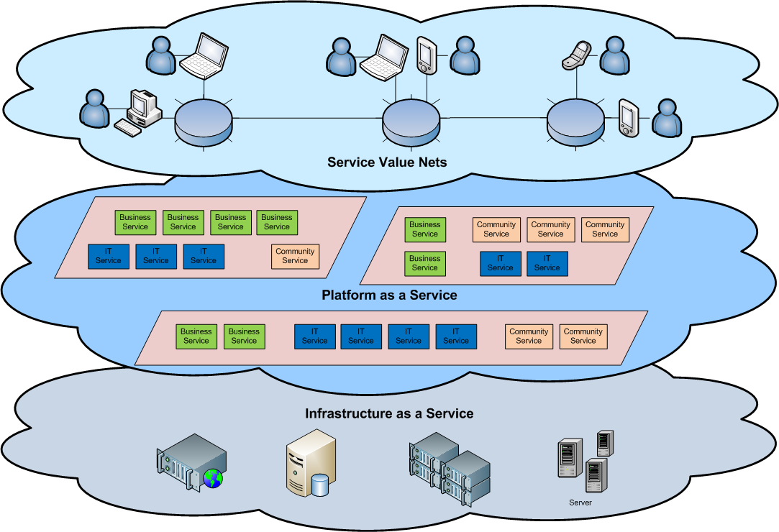
Cloud Architecture

Slide 7
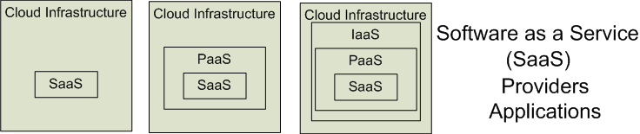

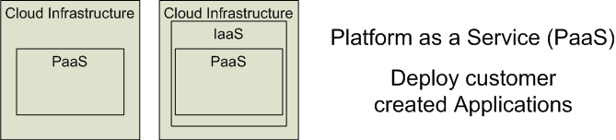
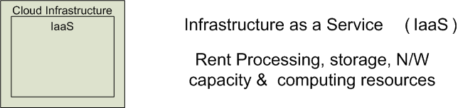


Cloud Service Models
Software as a Service (SaaS)
Platform as a Service (PaaS)
Infrastructure as a Service (IaaS)
Gmail, Dropbox
Salesforce,
Google G Suit
Google App Engine
GCP
Adopted from: Effectively and Securely Using the Cloud Computing Paradigm by peter Mell, Tim Grance
Notes:
IaaSdelivers computer infrastructure, typically a platform virtualization environment, as a service. Rather than purchasing servers, software, data center space or network equipment, clients instead buy those resources as a fully outsourced service.
PaaSdeliver a computing platform where the developers can develop their own applications.
SaaSis a model of software deployment where the software applications are provided to the customers as a service.

Slide 8
Advantages and Benefits of Cloud Computing
pay as much as used and needed
always on!, anywhere and any place
The “flexibility and elasticity” allows these systems to scale up and down at will
utilising the resources of all kinds
CPU, storage, server capacity, load balancing, and databases

Slide 9
Virtual Machines
VM technology allows multiple virtual machines to run on a single physical machine.
App
App
App
App
App
Xen
Guest OS
(Linux)
Guest OS
(NetBSD)
Guest OS
(Windows)
VMWare
VM
VM
VM
Virtual Machine Monitor (VMM) / Hypervisor
Virtual Box
KVM
Hardware
etc.
Performance: Para-virtualization (e.g. Xen) is very close to raw physical performance!

Slide 10
What other Cloud Providers?
AWS
Google Cloud P.
Microsoft Azure
Rackspace
IBM Cloud
Oracle Cloud
Alibaba Cloud
Etc.

Slide 11
AWS : Core Services
Overview of Services and Categories
AWS Global Infrastructure
Regions
Availability Groups
Edge Locations
Amazon (VPC) Virtual Private Cloud
Security Groups
Amazon EC2
Amazon S3
AWS Database Solutions
Amazon Aurora
Amazon RDS
Amazon DynamoDB

Slide 12
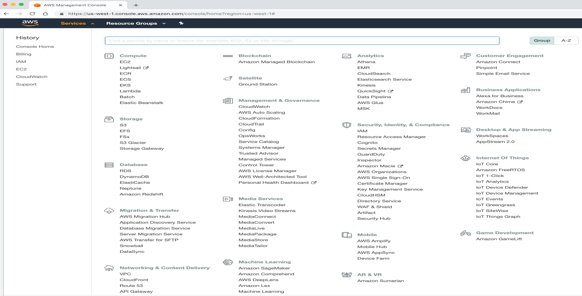
Overview of Services and Categories
Overview of Services and Categories
https://aws.amazon.com/. → Explore Our Products

Slide 13
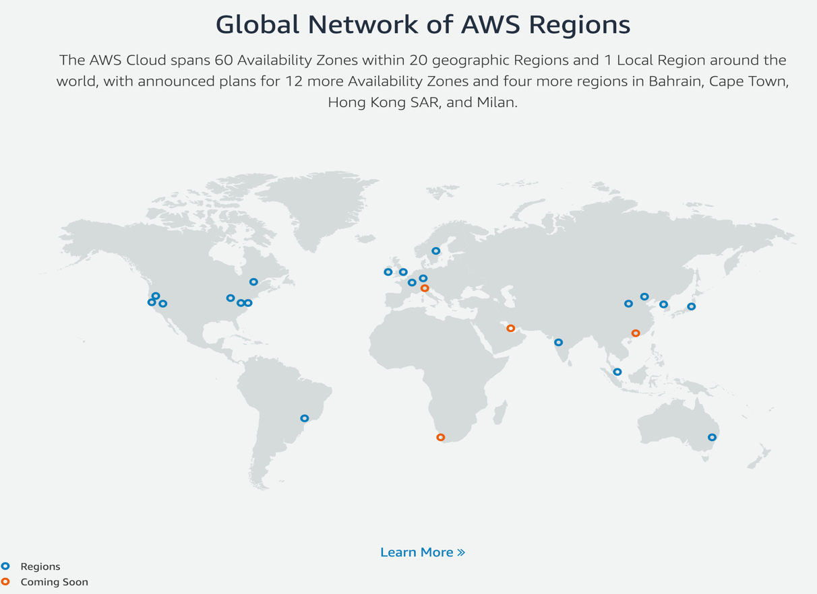
AWS Global Infrastructure
AWS Global Infrastructure
Regions
Availability Groups
Edge Locations

Slide 14
Amazon (VPC) Virtual Private Cloud

Slide 15
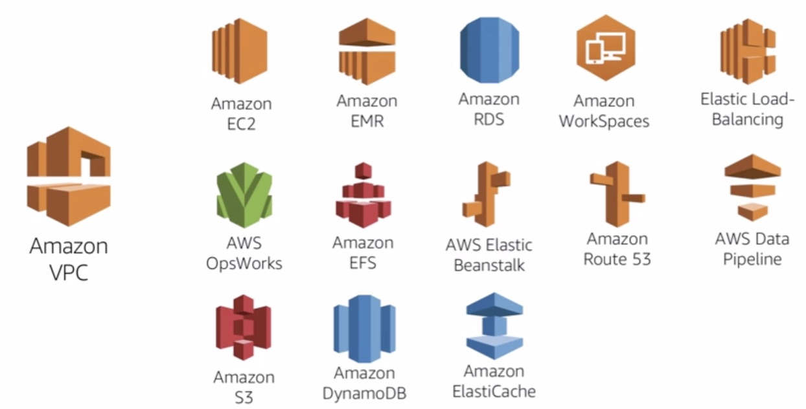
Amazon (VPC) Virtual Private Cloud

Slide 16
Features – Amazon VPC

Slide 17
Example – VPC

Slide 18
Security Groups

Slide 19
Key Pair
Key pair Downloaded

Slide 20
Amazon EC2 – Demo
Creating EC2 instance
Login with userX to the 151796043006 (mbilgenAWS2) account
Create Security group with
ssh, http, icmp, https, RDP allowed IP CIDR: 0.0.0.0/0
Create Key Pair
userX@mbilgenAWS2
Download key.pem file in a secure place
Launch/Create Instance / VM
Check Region – US West1 (California)
Step -1 : Select Amazon Linux AMI – Free tier
Step -2 : Select t2.micro (Free tier)
Step-3 : Configure Instance Details

Slide 21
Amazon EC2 – Demo (Continue)
Step-3 : Configure Instance Details (Continue)
Network : Default VPC
Subnet : us-west-1a
Remaining as default values
Next : Add Storage
Step 4 :Add Storage
Leave as is
Step 5 : Add Tag
Leave as is
Step 6 : Configure Security Group
Select existing sg group –each user use their own

Slide 22
Amazon EC2 – Demo (Continue)
Step 7 : Review Instance Launch
Launch
Select existing Key Pair
Each user choose their own key pair
Launch Instance
Connecting EC2-Linux Instance via Mac PC
Open Terminal
chmod 400 userXpem.file
$ ssh ec2-user@X.X.127.213 -i userXmbilgenAWS2.pem

Slide 23
Amazon EC2 – Demo (Continue)
Connecting EC2 Linux Instance via Windows PC
Download MSI 64 bit (‘Windows Installer’)
https://www.chiark.greenend.org.uk/~sgtatham/putty/latest.html
puttygen.exe -> Key Generator
Convert .pem file to .ppk file
Convection -> import key file ->
Select pem file -> Save Private Key as .ppk
putty.exe ->open
Hostname IP : set your EC2 VM IP
ec2-user is the default username for AWS Amazon AMI

Slide 24
Amazon EC2 – Demo (Continue)
putty.exe ->open-> Select .ppk key file (putty compatible)
Run
Please do your self NOW!

Slide 25
Word Press installation (Demo)
Update Linux Packages
sudo yum update -y
Install the Apache Web Server
yum install httpd
service httpd start
Install PHP
yum install php php-mysql
service httpd restart
cd /var/www/html pine test.php
http://ec2-54-193-127-213.us-west-1.compute.amazonaws.com/test.php
Install MySQL
yum install mariadb
service mysqld start
Secure your database:
mysqladmin -uroot create blog (optional)

Slide 26
Word Press installation (Demo)
Install WordPress
cd /var/www/html wget http://wordpress.org/latest.tar.gz tar -xzvf latest.tar.gz
mv wordpress blog
Create the WordPress wp-config.php file: cd blog mv wp-config-sample.php wp-config.php vi wp-config.php
Modify the database connection parameters as follows: define(‘DB_NAME’, ‘blog’); define(‘DB_USER’, ‘root’); define(‘DB_PASSWORD’, ‘YOUR_PASSWORD’); define(‘DB_HOST’, ‘localhost’);

Slide 27
Linux Apache MySql Php (Demo)
Tutorial:
Install a LAMP Web Server on Amazon Linux 2
https://docs.aws.amazon.com/AWSEC2/latest/UserGuide/ec2-lamp-amazon-linux-2.html

